Slide 1
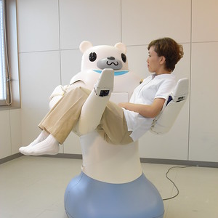
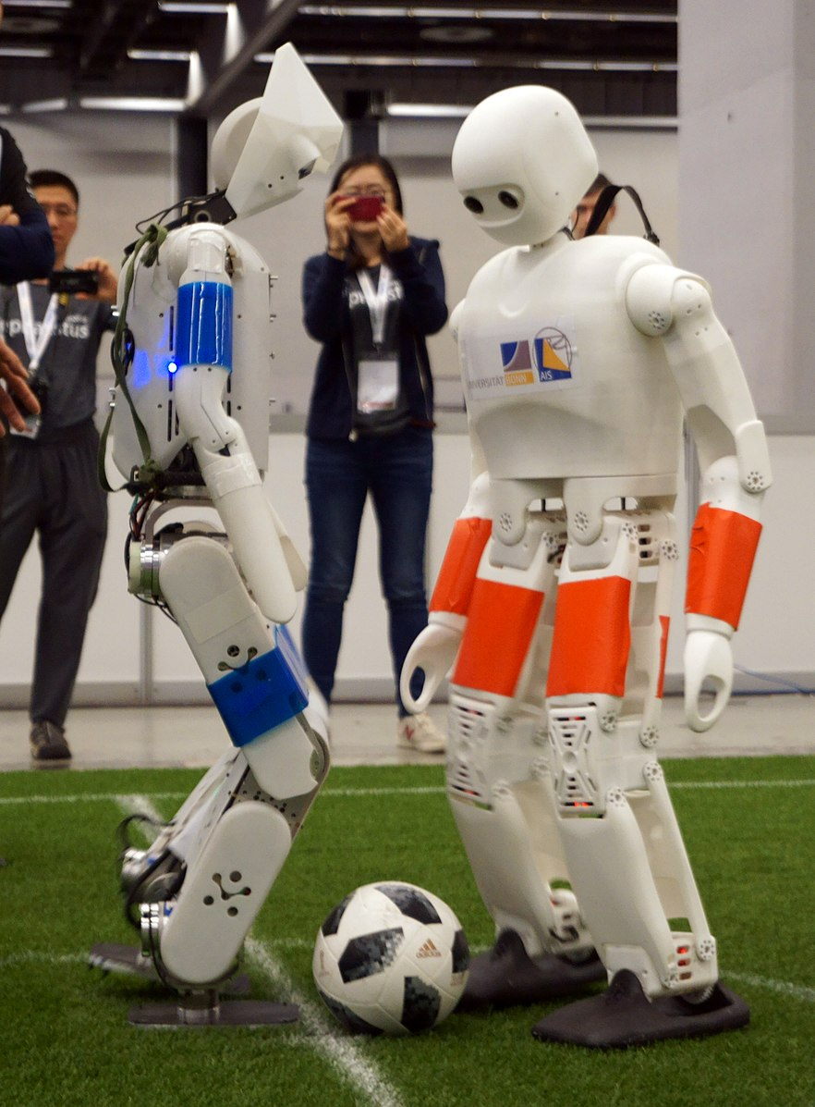
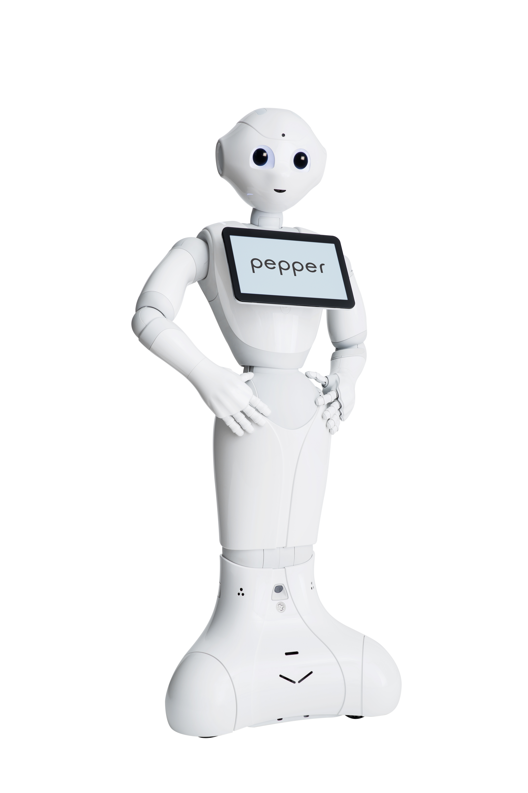
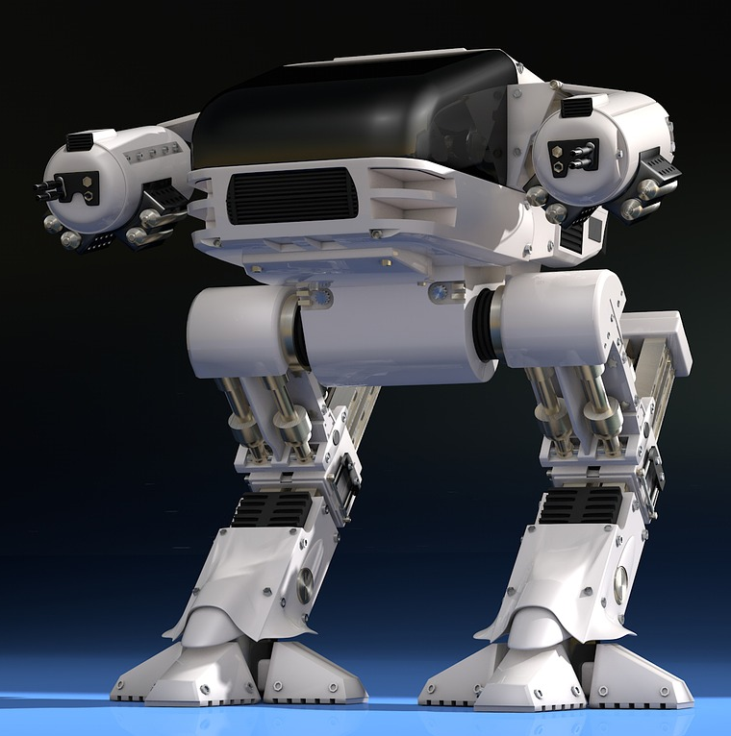


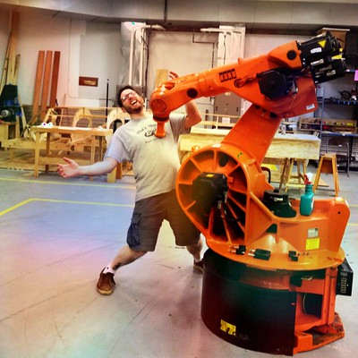


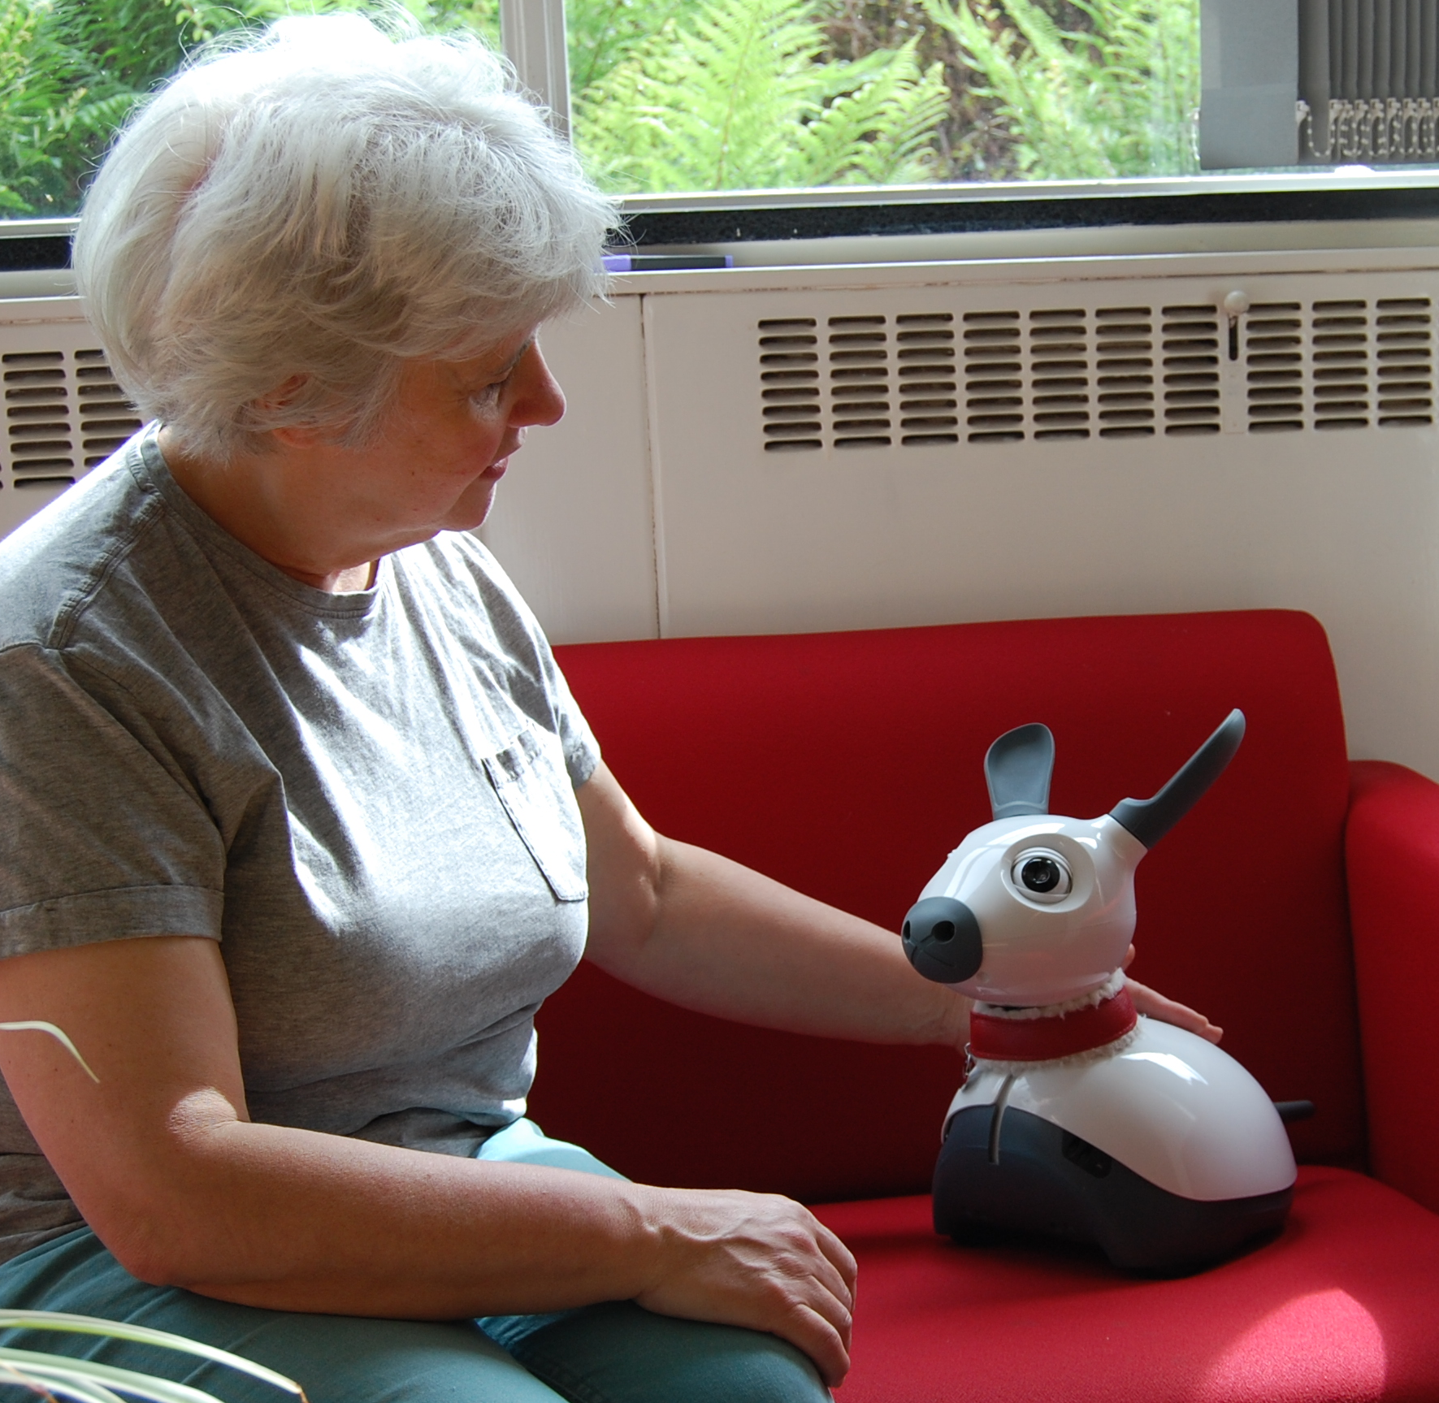


Browse Tech News
Browse Tech News
Browse Tech News
 | Families raise concern over use of robots in care home
 | 7 killed in accident involving autonomous car. Are they safe?
 | Robots introduced into local factory for first time, workers fear for their jobs
 | Fears as Big Brother invades the home through Assistive Robots monitoring your every move
 | Robots challenge humans in their own sports and win, is this the singularity?
 | Robots fight as war continues to rage without any human casualties for 10 consecutive years
 | First union formed for robot workers rights
 | Robots disguised as humans are walking undetected on our streets. Are they getting too human?
 | How far would you trust your robot companion and should you?
 | Court case against human charged with rape of a robot continues into second day
 | Appeals court due to rule on removal of reset buttons on intelligent robots
 | First criminal sentence due to be issued by a robot judge today

